Slide 1
Analysis of Model Selection when Predicting Business Cycle Turning Points
Dylan McDowell Econ 499 Senior Project

Slide 2
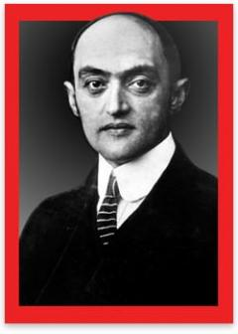
Analyzing business cycles means neither more nor less than analyzing the economic process of the capitalist era....
Cycles are not like tonsils, separable things that might be treated by themselves, but are, like the beat of the heart, the essence of the organism that displays them.
- Joseph A. Schumpeter (1939)

Slide 3
In this presentation
Discuss the history of modeling recessions
Build upon a previously published DF-MSM Model
Analyze the performance of a Neural Network Model
The goal is to develop a deeper understanding of what goes into modeling recessions and add to the current literature.

Slide 4
All Models are Wrong…
But some are useful

Slide 5
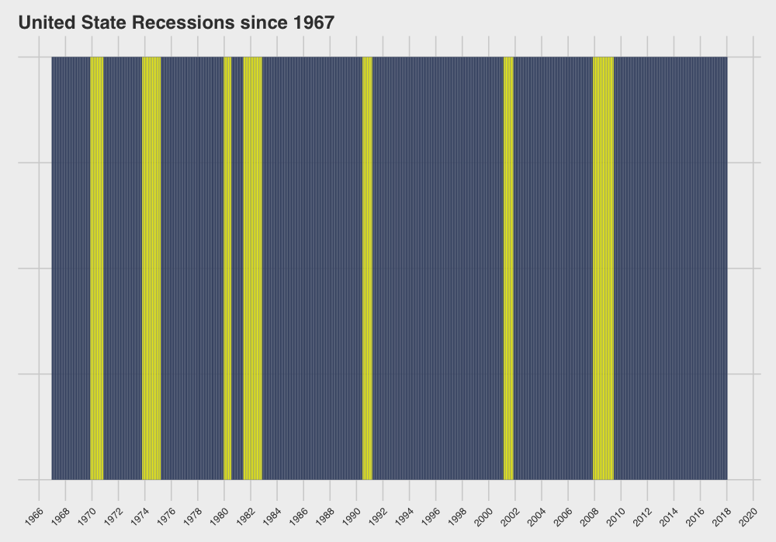

Slide 6
History of Understanding Business Cycles
First Systematic Exposition of Periodic Economic Crises
Eugen Slutsky shows that stochastic processes can generate predictable wave like patterns
1819
1927
1860
1950’s
Clement Jugular establishes business cycles to be 7-11 years long
Focus has shifted away from establishing the existence of business cycles to identifying cycles

Slide 7
The Problem with Forecasting
Linear models begin to break down when assumptions are broken
Slutsky was perturbed at economists using sunspot data to forecast economic cycles
Perhaps the economy is the “summation of random causes”
Prediction is futile

Slide 8

Big Think - Finance
Finance is an art of creativity
The goal is to predict the most accurate future
This ends up being much harder than expected

Slide 9
This leaves us with determining the present
Dynamic Factor
Markov Switching Model
A model developed in the early 1980’s to infer the current unobservable state with proxy data. Also known as a Regime Switching model
Neural Networks
A machine learning classifier modeled after the human brain, developed in the 1940’s but fell out of favor when it couldn’t solve XOR problems.

Slide 10
Regime Switching
A
B
Inferring expansionary or recessionary states

Slide 11



Imagine you’re in a windowless building
Rainy
Sunny
Apocalypse

Slide 12
Same idea but with the economy
Real Manufacturing & Trade Sales,
Industrial Production,
Nonfarm Payroll,
Real Personal Income,
10 Year - 3 Month Treasury Spread
SPX Volatility Index

Slide 13
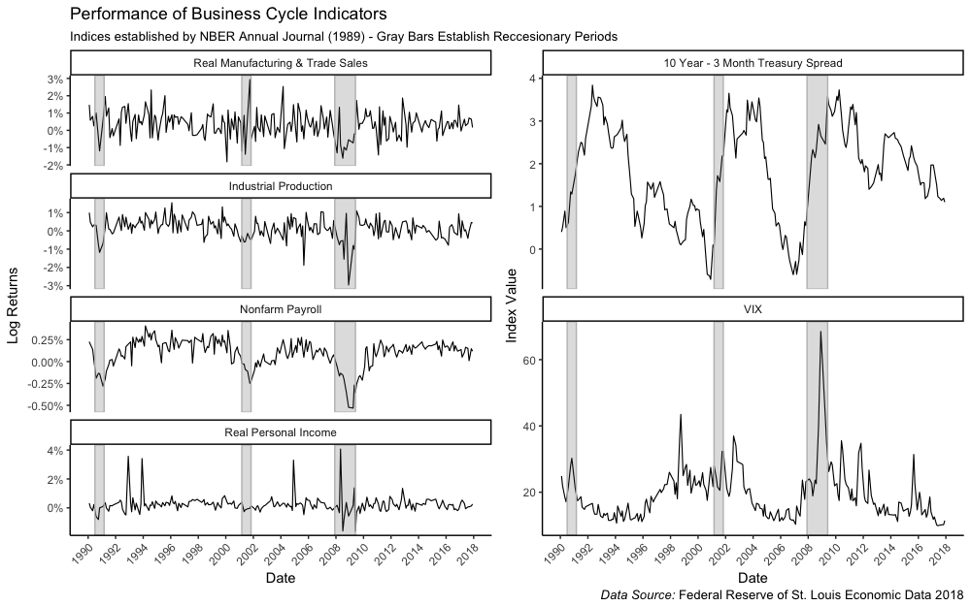

Slide 14
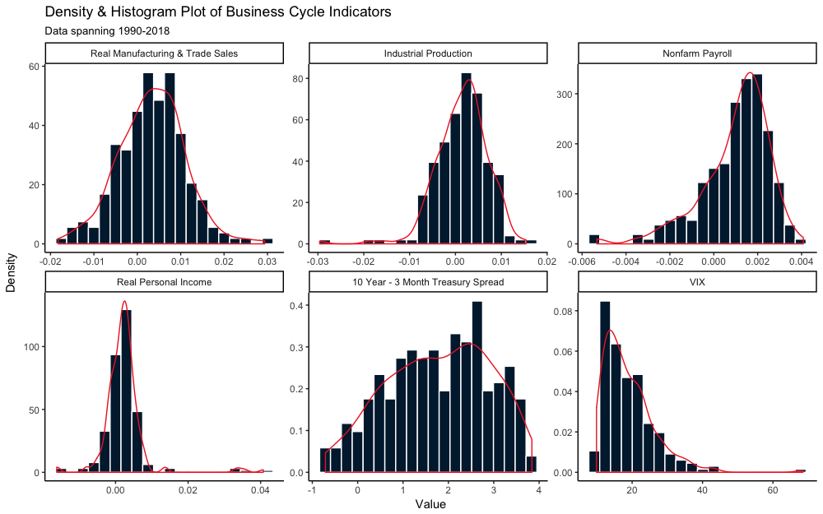
Bayesian Priors
Started with all Gaussian Priors for simplicity
Further research could be done developing more informative priors

Slide 15
Results
Full Model
AIC: -5120.499
BIC: -5029.618
Reduced Model
AIC: -19480.16
BIC: -19396.24

Slide 16
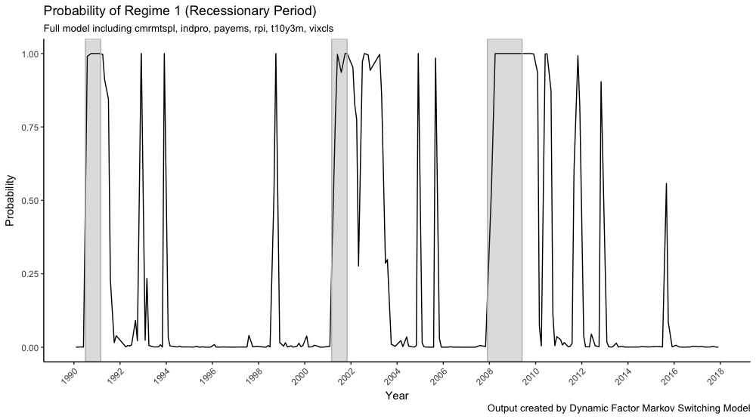

Slide 17
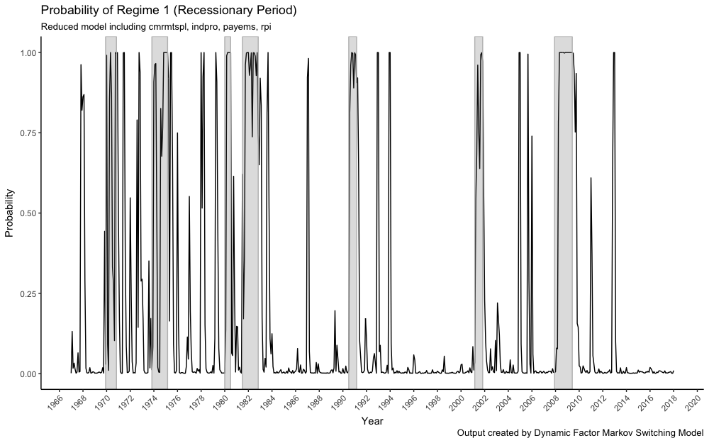

Slide 18
Neural Networks
Classifying Current Economic State

Slide 19
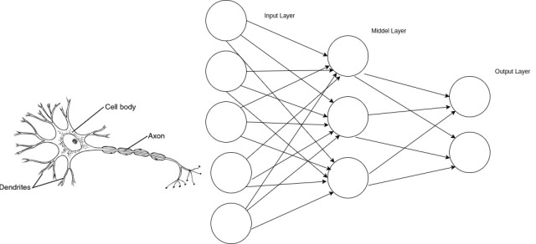
Neural Nets are designed after your brain

Slide 20
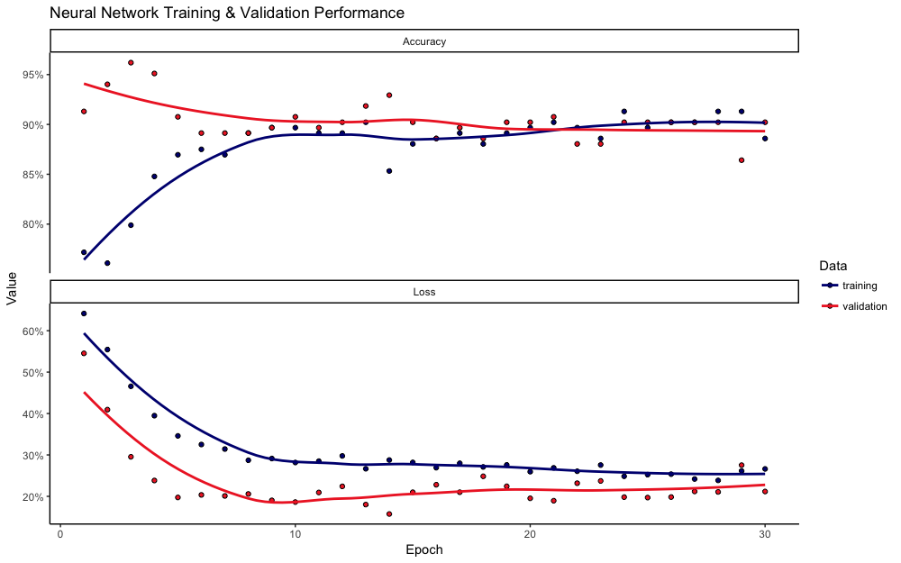
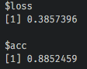

Slide 21

So what model should we use?

Slide 22
Why these models?
Dynamic Factor
Markov Switching Model
Pro: No assumption of linearity
Pro: Bayesian methods are powerful
Pro: Interpretable output
Con: Sensitive to priors
Con: Smoothing effect
Neural Networks
Pro: Can be highly accurate
Pro: Quick & easy to train
Pro: Any variables may work
Con: Uninterpretable Output
Con: Not widely accepted in Economics

